Slide 1
Data Structure and Algorithm Using Java

Slide 2
Table of Content
AIM
2. Overview of Algorithm
2.1.Brief idea of algorithms
2.2. Asymptotic notations
2.3. the notion of time and space

Slide 3

Aim
To equip students in the fundamentals and understanding of Algorithms and it’s analysis.

Slide 4

Start using frameworks for describing and
analyzing algorithms.
• Examine algorithms :
simple algorithms
insertion sort
• See how to describe algorithms in pseudo code.
• Begin using asymptotic notation to express
running-time analysis.
Objective

Slide 5
What is an Algorithm ?
An algorithm is any well defined computational procedure that takes some value or set of values, as input and produces some value or set of values as output.
We can also view an algorithm as a tool for solving a well specified computational problem.

Slide 6
Characteristics of an Algorithm
Input: provided by the user.
Output: produced by algorithm.
Definiteness: clearly define.
Finiteness: It has finite number of steps.
Effectiveness: An algorithm must be effective so that it’s output can be carried out with the help of paper and pen.

Slide 7
Analysis of an Algorithm
Done in three steps:
Initialization
Maintenance
Termination
It deals with predicting the resources that an algorithm requires to its completion such as memory and CPU time.
Two main measure for the efficiency of an algorithm are Time and space.

Slide 8
Complexity of an Algorithm
Complexity of an Algorithm is a function, f(n) which gives the running time and storage space requirement of the algorithm in terms of size n of the input data.
Space Complexity: Amount of memory needed by an algorithm to run its completion.
Time complexity: Amount of time that it needs to complete itself.

Slide 9
Cases in Complexity Theory
Best Case: Minimum time
Worst Case: Maximum amount of time
Average Case: Expected / Average value of the function f(n).

Slide 10
Example 1
A()
{
int i;
for(i=1;i<=n;i++)
{
printf(“ABCD”);
}
}

Slide 11
Complexity of Example 1
T= O(n)

Slide 12
Example 2
A()
{
int i=1 ,s=1;
scanf(“%d”, &n);
while(s<=n)
{
i++;
s=s+i;
printf(“abcd”);
}
}

Slide 13
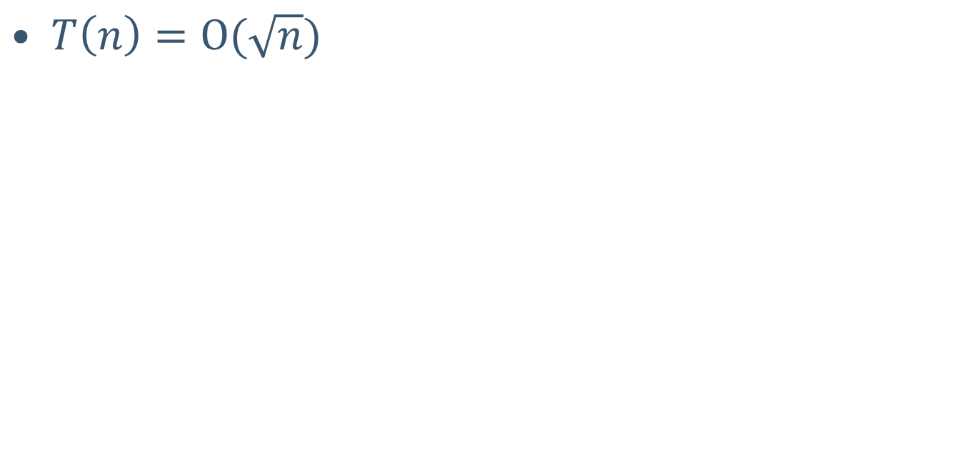
Complexity of Example 2

Slide 14
Example 3
A()
{
int i=1;
for(i=1; i pow 2<=n; i++)
{
printf(“abcd”);
}
}

Slide 15
Complexity of Example 3

Slide 16
Example Problem1:Linear Search
We are given a list of records.
Each record has an associated key.
Give efficient algorithm for searching for a record containing a particular key.
Efficiency is quantified in terms of average time analysis (number of comparisons) to retrieve an item.

Slide 17
Linear Search
[ 0 ]
[ 1 ]
[ 2 ]
[ 3 ]
[ 4 ]
[ 700 ]
…
Number 701466868
Number 281942902
Number 233667136
Number 580625685
Number 506643548
Number 155778322
Each record in list has an associated key.
In this example, the keys are ID numbers.
Given a particular key, how can we efficiently retrieve the record from the list?
Number 580625685

Slide 18
Serial Search
Step through array of records, one at a time.
Look for record with matching key.
Search stops when
record with matching key is found
or when search has examined all records without success.

Slide 19
Pseudocode for Serial Search
// Search for a desired item in the n array elements
// starting at a[first].
// Returns pointer to desired record if found.
// Otherwise, return NULL
…
for(i = first; i < n; ++i )
if(a[first+i] is desired item)
return &a[first+i];
// if we drop through loop, then desired item was not found
return NULL;

Slide 20
Serial Search Analysis
What are the worst and average case running times for serial search?
We must determine the O-notation for the number of operations required in search.
Number of operations depends on n, the number of entries in the list.

Slide 21
Worst Case Time for Serial Search
For an array of n elements, the worst case time for serial search requires n array accesses: O(n).
Consider cases where we must loop over all n records:
desired record appears in the last position of the array
desired record does not appear in the array at all

Slide 22
Average Case for Serial Search
Assumptions:
All keys are equally likely in a search
We always search for a key that is in the array
Example:
We have an array of 10 records.
If search for the first record, then it requires 1 array access; if the second, then 2 array accesses. etc.
The average of all these searches is:
(1+2+3+4+5+6+7+8+9+10)/10 = 5.5

Slide 23
Average Case Time for Serial Search
Generalize for array size n.
Expression for average-case running time:
(1+2+…+n)/n = n(n+1)/2n = (n+1)/2
Therefore, average case time complexity for serial search is O(n).

Slide 24
Binary Search
Perhaps we can do better than O(n) in the average case?
Assume that we are give an array of records that is sorted. For instance:
an array of records with integer keys sorted from smallest to largest (e.g., ID numbers), or
an array of records with string keys sorted in alphabetical order (e.g., names).

Slide 25
Binary Search Pseudocode
…
if(size == 0)
found = false;
else {
middle = index of approximate midpoint of array segment;
if(target == a[middle])
target has been found!
else if(target < a[middle])
search for target in area before midpoint;
else
search for target in area after midpoint;
}
…

Slide 26
Binary Search
Example: sorted array of integer keys. Target=7.
[ 0 ]
[ 1 ]
[ 2 ]
[ 3 ]
[ 4 ]
[ 5 ]
[ 6 ]
3
6
7
11
32
33
53

Slide 27
Thank you

